Slide 1
ANALYSIS OF GLOBAL DEVELOPMENT DATA
DANA 4840-001
Lien Pham
Mohamed Ghayaas
Ayushi Singh
Mary Ann Villamor

Slide 2
CONTENTS
01
Theory
01
Introduction
02
DATA
PRE-PROCESSING
03
APPROPRIATE K and CLUSTERING METHODS
04
CLUSTERING AND ANALYSIS
05
CONCLUSIONS/ RECOMMENDATIONS
Overview of the data
Audience/user of the clustering analysis
Data Cleaning
Selecting the relevant variables
Data Imputation
Select relevant clustering methods
Select optimal k
Interpretation of the clusters
Assess the quality and reliability of clustering results by critical thinking
Conclusions of all the analysis results
Recommendations on how to improve analysis in the future

Slide 3
1. INTRODUCTION
DATASET
PURPOSE
2010 World Bank Economic Data
Cluster the countries and detect groups’ characteristics to support World Bank to assess the countries for decision making
DATA OVERVIEW
TARGET AUDIENCE
214 Countries
33 variables (28 numerical data)
Comprises of economic, population, education and health factors
The World Bank Group works in every major area of development. They provide a wide array of financial products and technical assistance to help countries to eradicate poverty and increase life’s quality. Their specific goals are:
Eradicate poverty and hunger
Achieve universal primary education
Promote gender equality and empower women
Reduce child mortality
Improve maternal health
Combat HIV/AIDS, malaria, and other diseases
Ensure environmental sustainability
2.
Source: World Bank development indicator 2010

Slide 4
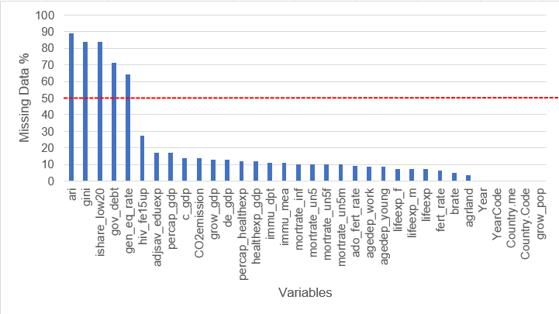
2. DATA PRE-PROCESSING
1,383 (20%) missing data
01
MISSING DATA
02
RELEVANT DATA
5 variables with > 50% missing data
Redundancies
Categorical variables not needed for analysis:
Year
Year Code
Country name
Highly correlated data
lifeexp_f | Life expectancy at birth, female (years)
lifeexp_m | Life expectancy at birth, male (years)
Lifeexp * | Life expectancy at birth, total (years)
mortrate_inf * | Mortality rate, infant (per 1,000 live births)
mortrate_un5 * | Mortality rate, under-5 (per 1,000 live births)
mortrate_un5f | Mortality rate, under-5, female (per 1,000)
mortrate_un5m | Mortality rate, under-5, male (per 1,000)
Range | Count | Rate %
>=80% | 5 | 2.34%
>=60% < 80% | 6 | 2.80%
>=50% <60% | 11 | 5.14%
>=30% <50% | 12 | 5.61%
>=20% <30% | 11 | 5.14%
> 20% | 169 | 78.97%
Total | 214 | 100.00%
34 countries/rows with > 30% missing data
* removed
Data added – CO2 emission!
Goal #7: Ensure environmental sustainability (World Development Indicator 2010, World Bank)

Slide 5
2. DATA PRE-PROCESSING
71 missing data (2%) after cleaning
variable | Before impute |  |  |  | After impute
 | Count | sd | min | max | Count | sd | min | max
adjsav_eduexp | 167 | 1.89 | 0.84 | 12.93 | 180 | 1.84 | 0.84 | 12.93
agrland | 179 | 22.14 | 0.5 | 88.4 | 180 | 22.08 | 0.5 | 88.4
c_gdp | 174 | 1.18 | 1.11 | 1.36 | 180 | 1.16 | 1.11 | 1.36
grow_gdp | 176 | 3.87 | -9.53 | 16.73 | 180 | 3.83 | -9.53 | 16.73
percap_gdp | 172 | 13493.07 | 335.68 | 70239.31 | 180 | 13274.73 | 335.68 | 70239.31
percap_healthexp | 179 | 1683.66 | 12.7 | 8232.88 | 180 | 1680.26 | 12.71 | 8232.88
healthexp_gdp | 179 | 2.27 | 0.24 | 12.46 | 180 | 2.270844 | 0.24 | 12.46
de_gdp | 176 | 7.38 | -4.2 | 45.94 | 180 | 7.30906 | -4.2 | 45.94
immu_dpt | 179 | 12.48 | 33 | 99 | 180 | 12.49608 | 33 | 99
hiv_fe15up | 153 | 16.13 | 8.9 | 68 | 180 | 15.22359 | 8.9 | 68
03
IMPUTATION
Our dataset has multiple variables with high correlation and multicollinearity. Missing data was imputed using MissForest
MissForest is robust to noisy data and multicollinearity, since random-forests have built-in feature selection (evaluating entropy and information gain). KNN-Impute yields poor predictions when datasets have weak predictors or heavy correlation between features.
No significant changes for the SD, Mean and Max before and after imputation.

Slide 6
3. APPROPRIATE K and CLUSTERING METHODS
Internal criterion:
A good clustering will produce high quality clusters in which:
The intra-class (that is, intra-cluster) similarity is high
The inter-class similarity is low
The measured quality of a clustering depends on both the document representation and the similarity measure used
Internal criterion is used when we don’t have a ground of truth or expert knowledge.
Silhouette coefficient
CH score
Agglomerative coefficient:
measures the amount of clustering structure of the dataset
If observations quickly agglomerate into distinct clusters that later agglomerate into a single cluster at much greater dissimilarities, the coefficient will approach 1
In contrast, no clustering for the dataset will have coefficient approaching zero

Slide 7
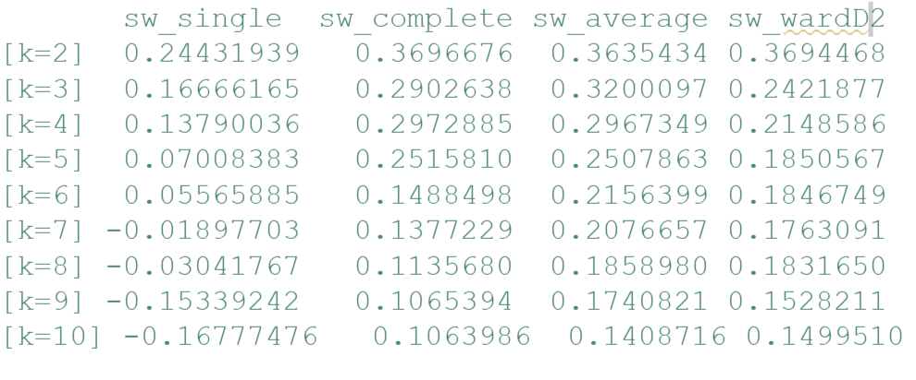
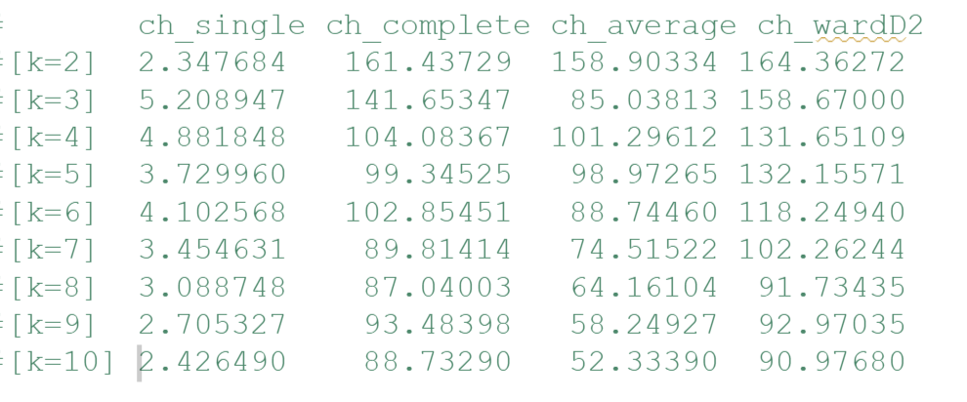
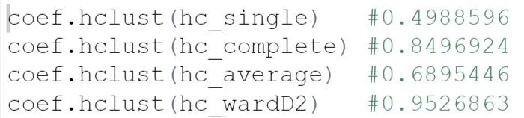
3. APPROPRIATE K and CLUSTERING METHODS
Note:
The same methods were peformed on kmeans, kmedoid and hierarchal wardD2 and wardD2 has highest silhouette and CH scores
Silhouette score
Ward D2 has highest silhouette and CH score, with optimal k = 2
CH score
- Agglomerative ward clustering seems to give a better structure, in comparison to the other clustering technique
Agglomerative coefficient

Slide 8
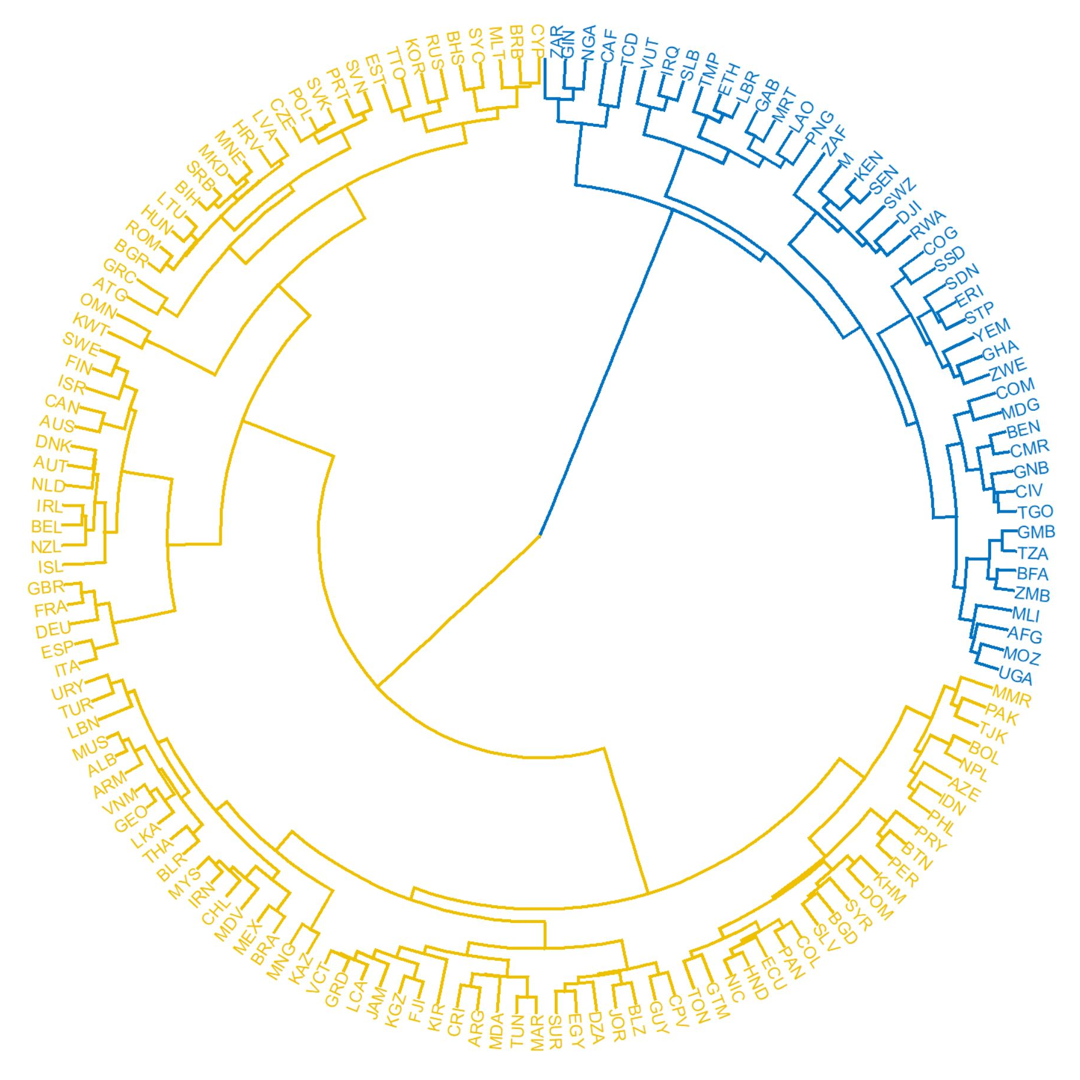
4. Cluster Interpretation
Cluster 1
Number of countries – 45
Example - Afghanistan, Ethiopia, South Africa, South Sudan, Central African Republic, Nigeria, Rwanda, Yemen, Uganda
Label : Low Income countries
Cluster 2
Number of countries – 106
Example - Australia, Oman, New Zealand, Denmark, Greece, Israel
Label: Middle (upper and lower) Income and High income
Cluster 1
Cluster 2
Notes:
Explain: according 2010 WB

Slide 9
4. Country’s Economy
Cluster 1 (Low Income Countries)
GDP per capita – Low
Health Expenditure Per Capita – Low
Heath Expenditure Public – Low
GDP Growth - High
Inflation – High
CO2 Emission - Low
Cluster 2 (Middle & High Income Countries)
GDP per capita – High
Health Expenditure Per Capita – High
Heath Expenditure Public – High
GDP Growth - Low
Inflation – Low
CO2 Emission - High

Slide 10
4. Population Health
Cluster 1 (Low income)
Life Expectancy (years)
Male – 57.1
Female – 59.7
Mortality Rate / Per 1000 births
Male – 92.15
Female – 81.03
Annual Population Growth – 2.58 %
Cluster 2 (Middle and high income)
Life Expectancy (years)
Male – 71.63
Female – 77.38
Mortality Rate / Per 1000 births
Male – 19.47
Female – 15.98
Annual Population Growth – 0.94 %

Slide 11
4. Population Health
Cluster 1 (Low income)
Birth Rate – High
Lower Immunization against DPT and Measles in children
Higher percentage of women 15+ of age living with HIV +
Cluster 2 (Middle and high income)
Birth Rate – Low
Higher Immunization against DPT and Measles in children
Lower percentage of women 15+ of age living with HIV +

Slide 12
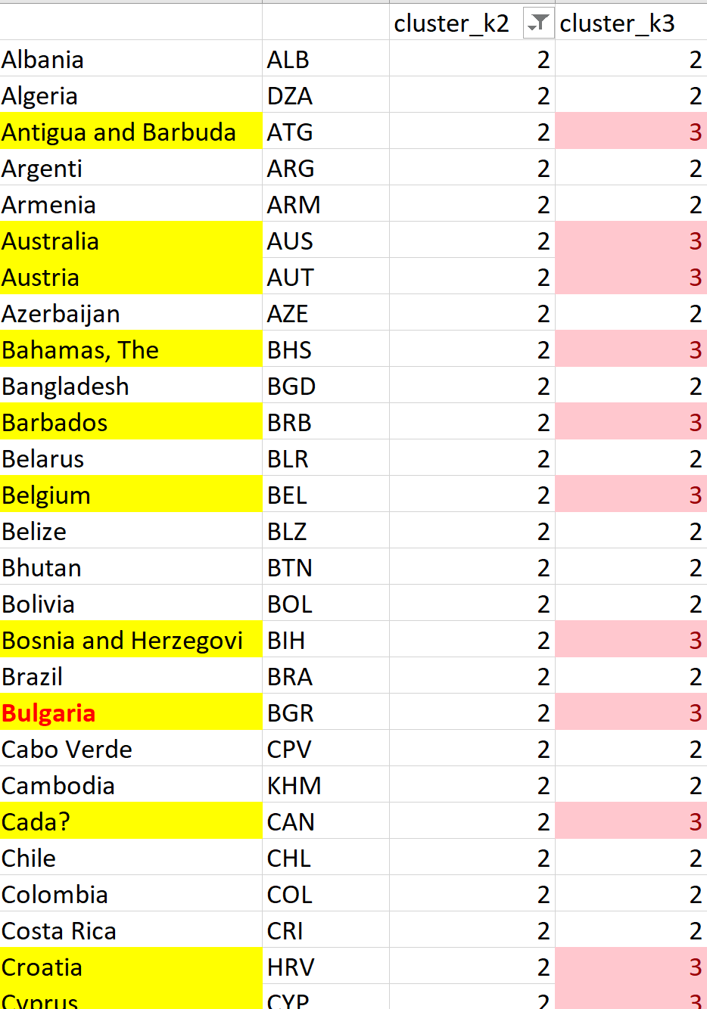
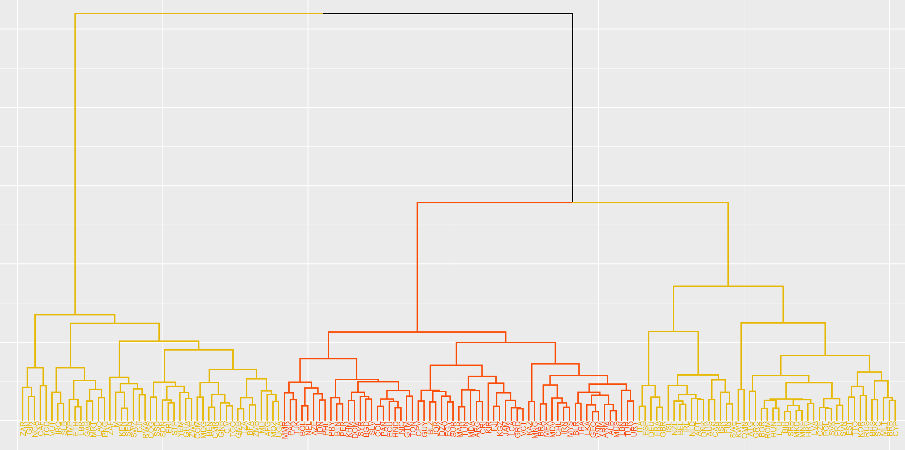
4. middle income (2) vs high income countries (3)
Most important variable – ‘brate’
Most important variable – GDP per capita
Cluster 1
Remains the same
Cluster 2
Cluster 3
Low income (45)
Middle income (61)
High income (45)
Afghanistan
Ethiopia
South Sudan
Central African Republic
Nigeria
Rwanda
Myanmar
Philippines
Thailand
Turkey
Malaysia
Vietnam
Peru
New Zealand
Denmark
Greece
Israel
Germany
Sweden
United Kingdom

Slide 13
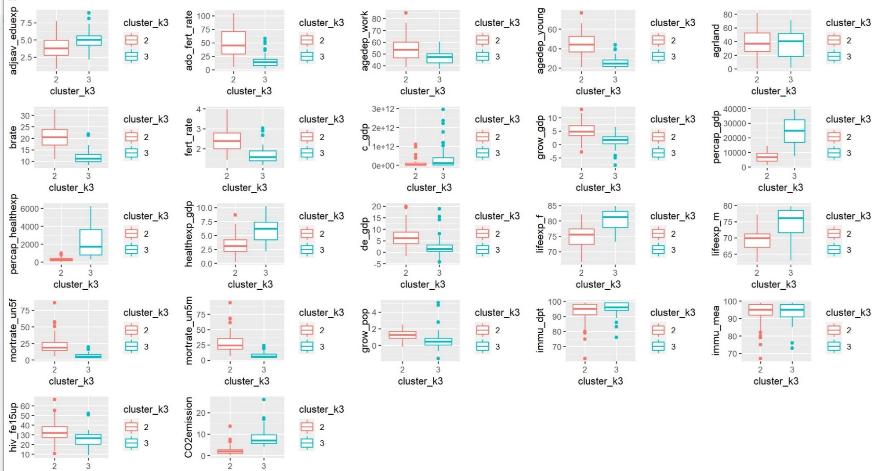
6. Middle income countries vs high income countries

Slide 14
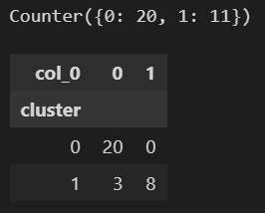
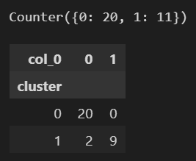
5. Use clusters’ labels for modelling
Encoding:
Cluster 1 – Low Income countries – 1
Cluster 2 – Middle & High Income - 0
Random Forest Accuracy – 90.32 %
XG Boost Accuracy – 93.54 %

Slide 15

5. CONCLUSIONS/RECOMMENDATIONS
From WB’s perspective
Deep dive into group 2 to analyze the countries that are middle income such as Philippine, Vietnam, Myanmar
Efforts shall be undertaken by the world bank to curb the high CO2 emission from developed countries alongside the other goals.
From algorithm perspective
Look for more variables such as criminal rate, clean water quality access rate, literacy rate to support World Bank’s goals/decision making if there is a specific goal
Perform analysis in cluster 2 to detect lower middle income countries
Try the clustering on the most recent dataset (2021) to detect the changes in clustering, trends and patterns
Notes:
Another m
Index-based Assessment: library(NbClust) – a number of indices are available to select the “optimal” number of clusters in a database. NbClust package provides 30 indices for determining the number of clusters (such as Milligan and Cooper, Dunn Index, Silhouette, Gap, Dindex, DD index, etc.)
The results returned include the amount of support for different number of clusters and the number of cluster based on the majority rule.
ethod to diagnostics the number and stability of clusters

Slide 16
QUESTIONS?

